Slide 1
COMPUTER GRAPHICS & IMAGE PROCESSING (21CS63)
VARALAKSHMI B D
ASSISTANT PROFESSOR
Department of Computer Science & Engineering
VI Semester
2023-24

Slide 2
What is Computer Graphics?
“Computer graphics is a sub-field of computer science and is concerned with digitally synthesizing and manipulating visual content.”
Computer graphics deals with all aspects of creating images with a computer- Imaging, Rendering, Modeling, Animation.
Hardware: PC with graphics card for modeling and rendering.
Software: OpenGL
Applications: Any

Slide 3
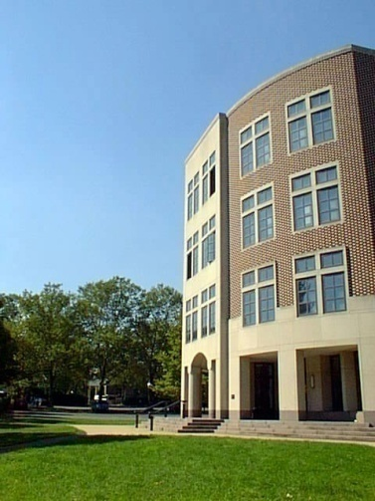
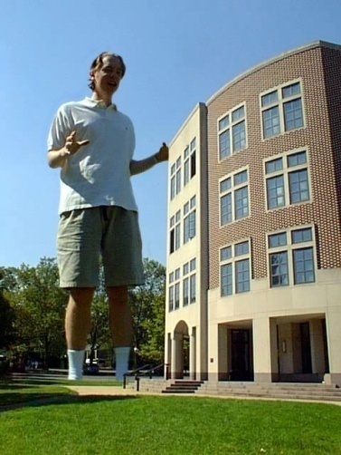
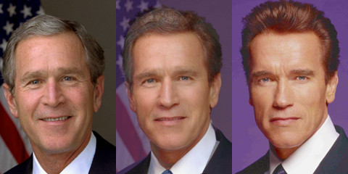
Imaging (Representing 2D images)
Image Representation
Sampling
Reconstruction
Quantization & Aliasing
Image Processing
Filtering
Warping
Morphing
Raster Graphics
Display devices
Color models
Image composition
Image morphing

Slide 4
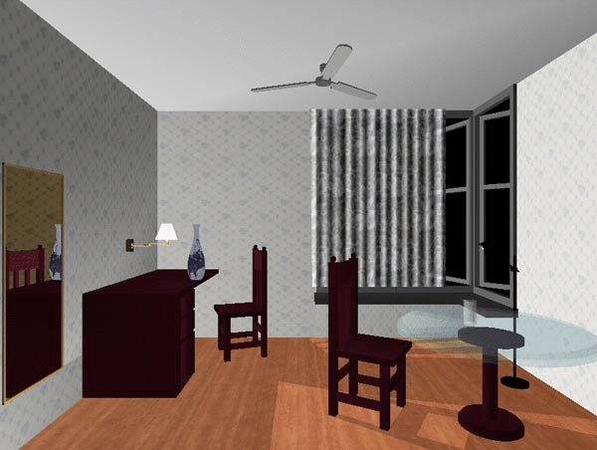
Rendering (Constructing 2D images from 3D models)
3D Rendering Pipeline
Modeling transformations
Viewing transformations
Hidden surface removal
Illumination, shading, and textures
Scan conversion, clipping
Hierarchical scene graphics
OpenGL
Global illumination
Ray tracing
Radiosity

Slide 5
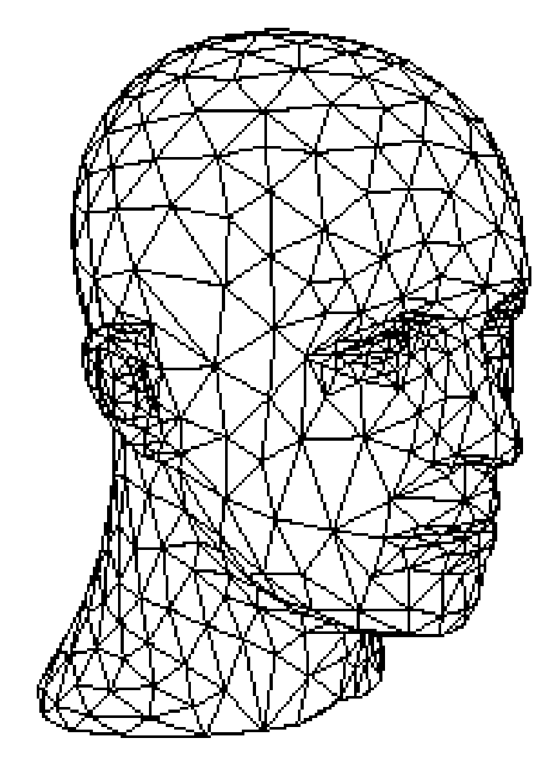
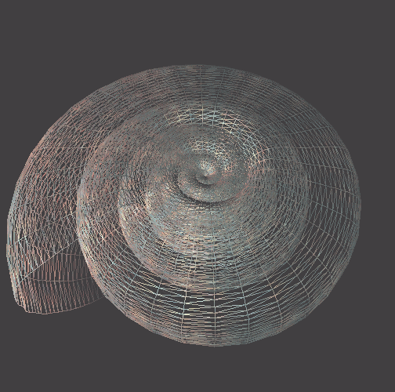
Modeling (Representing 3D objects)
Representations of geometry
Curves
Surfaces
Solids
Procedural modeling
Fractals mean
(relating to or of the nature of a fractal)
Shell
A curve or geometrical figure, each part of which has the same statistical character as the whole.

Slide 6
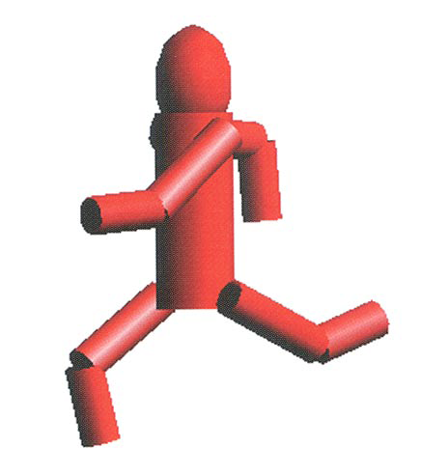
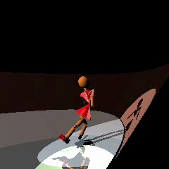
Animation (Simulating changes over time)
Key framing
Kinematics
Articulated figures
Motion capture
Dynamics
Physically-based simulations
Ice Queen

Slide 7
Graphics Applications
Graphs and charts
Computer-aided design
Virtual-Reality Environments
Scientific visualization
Education and Training
Computer art
Entertainment
Image Processing
Graphical User Interfaces

Slide 8
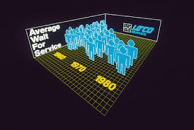
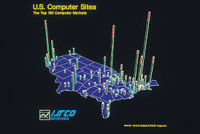
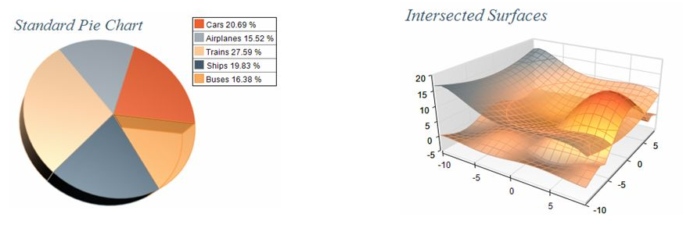
Data plotting with dramatic effect, commonly used to summarize financial, statistical, mathematical, scientific, engineering, and economic data for research reports, managerial summaries, consumer information bulletins and other types of publications
Graphs and charts
Computer-aided design
Virtual-Reality Environments
Scientific visualization
Education and Training
Computer art
Entertainment
Image Processing
Graphical User Interfaces

Slide 9
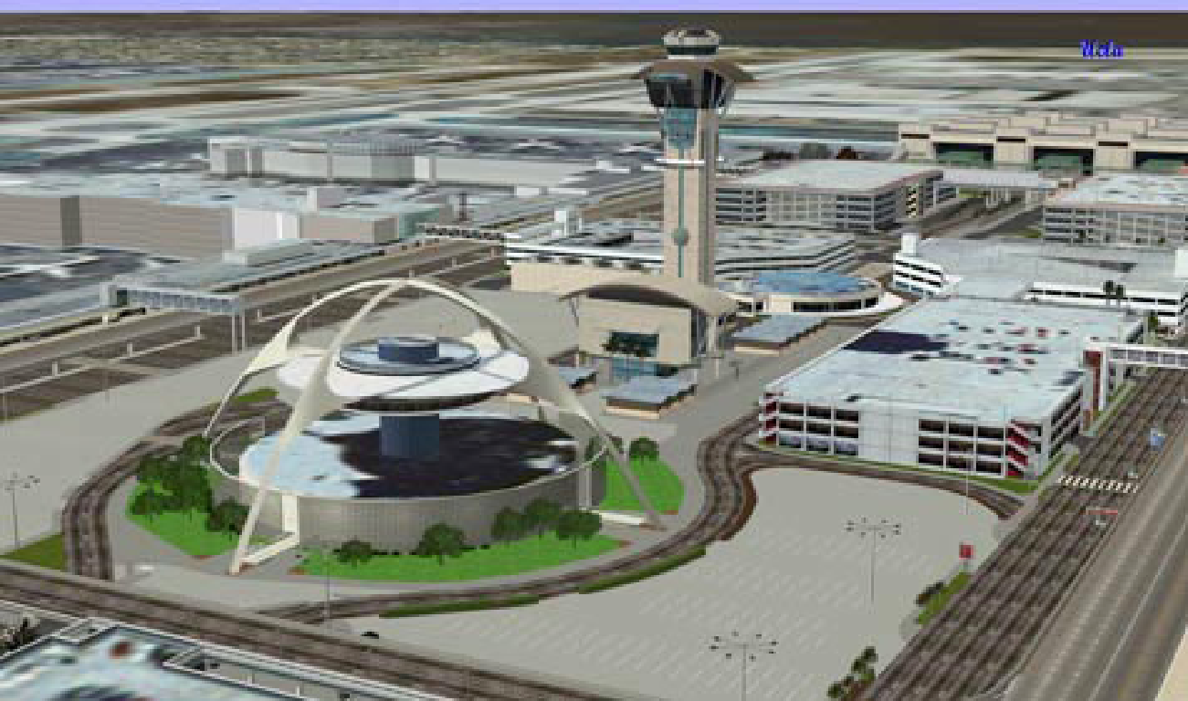
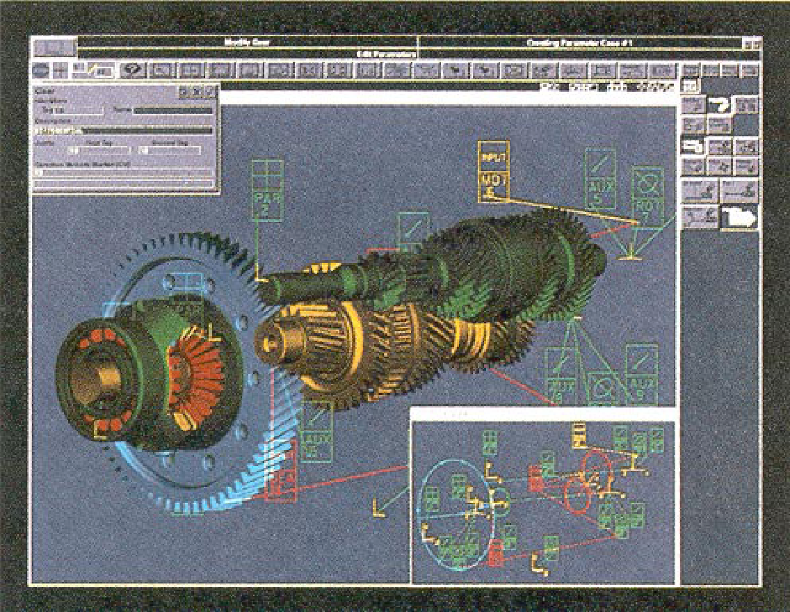
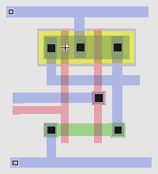
In design of building, automobiles, aircrafts, watercrafts, spacecrafts, computers, textiles, home appliances and a multitude of other products
Graphs and charts
Computer-aided design
Virtual-Reality Environments
Scientific visualization
Education and Training
Computer art
Entertainment
Image Processing
Graphical User Interfaces
Los Angeles Airport
Gear Shaft Design
CMOS Circuit Design
Contd…

Slide 10
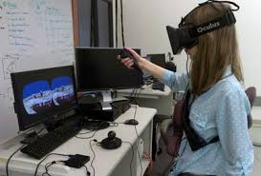
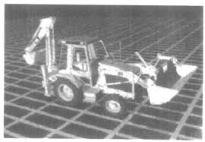
Such animations are often used to train heavy-equipment operators, analyze the effectiveness of various cabin configuration and control placements, users can interact with the objects in a 3D scene.
Graphs and charts
Computer-aided design
Virtual-Reality Environments
Scientific visualization
Education and Training
Computer art
Entertainment
Image Processing
Graphical User Interfaces

Slide 11
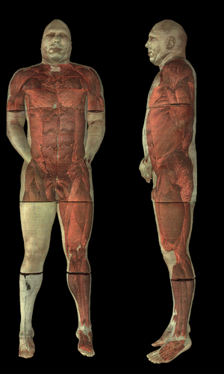
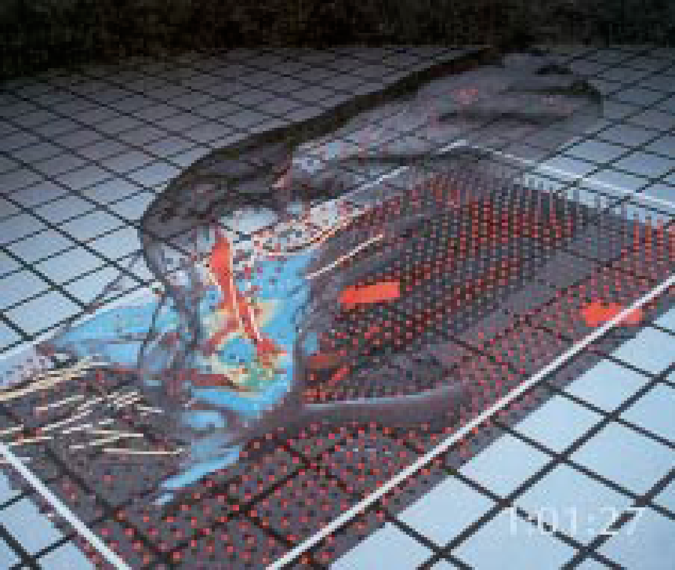
Also called data visualization: produces graphical representations for scientific, engineering and medical data sets and processes it. Business visualization is used in connection with data sets related to commerce, industry, and other nonscientific areas. Also used in understanding and analyzing complex processes and mathematical functions
Graphs and charts
Computer-aided design
Virtual-Reality Environments
Scientific visualization
Education and Training
Computer art
Entertainment
Image Processing
Graphical User Interfaces
Airflow inside a thunderstorm
Visible human
Contd…

Slide 12
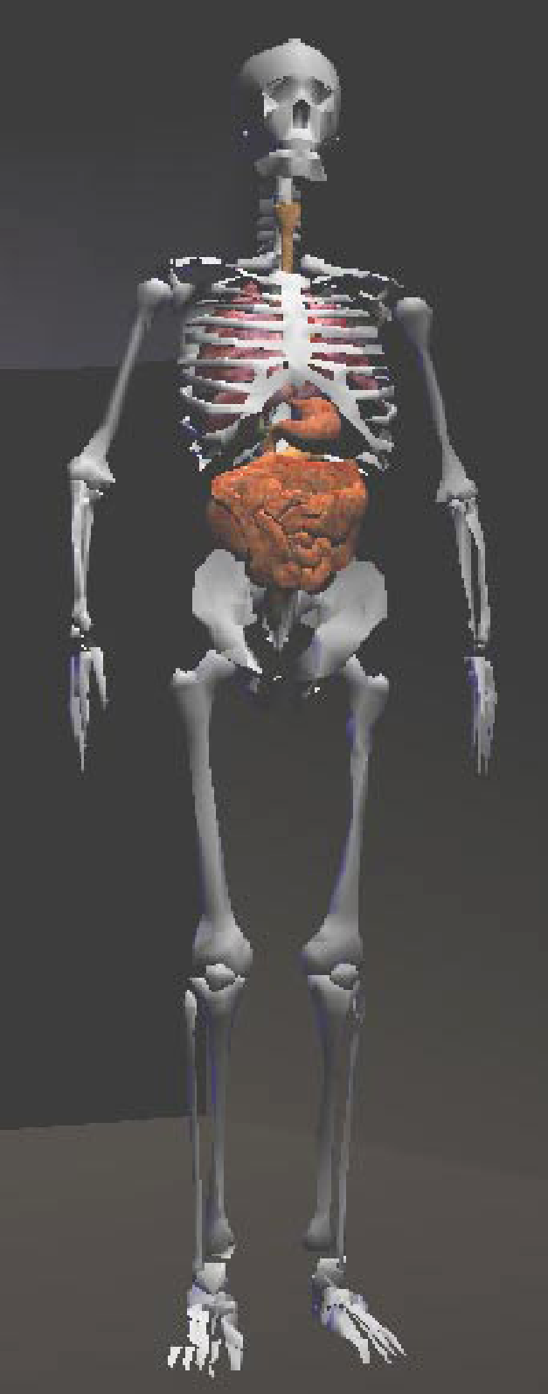
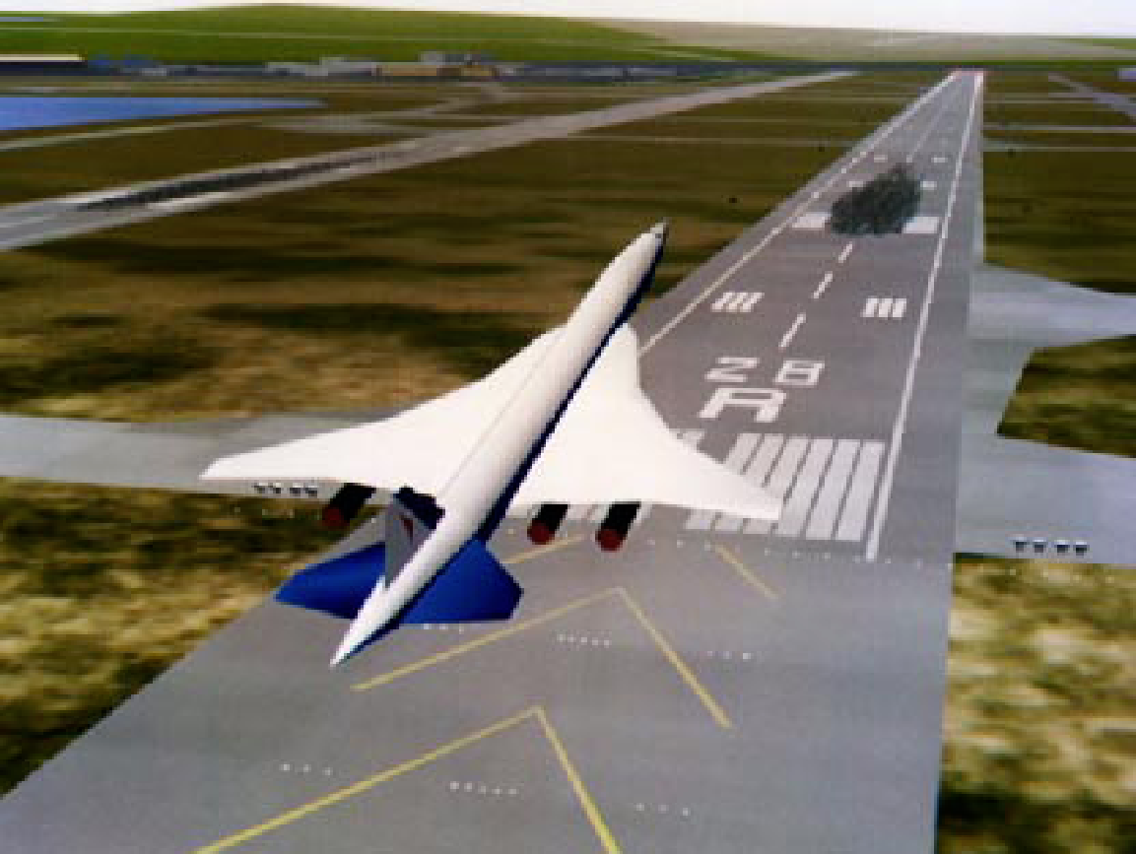
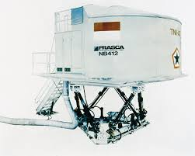
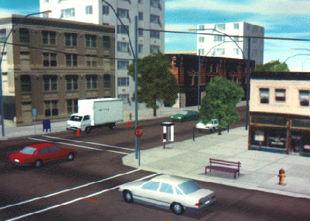
Computer generated models of physical, financial, political, social, economic, and other systems are often used as educational aids. Eg: color-coded diagram in operation of a nuclear reactor, aircraft, naval, spacecraft simulators
Graphs and charts
Computer-aided design
Virtual-Reality Environments
Scientific visualization
Education and Training
Computer art
Entertainment
Image Processing
Graphical User Interfaces
Flight Simulation
Flight Simulation
Driving Simulation

Slide 13
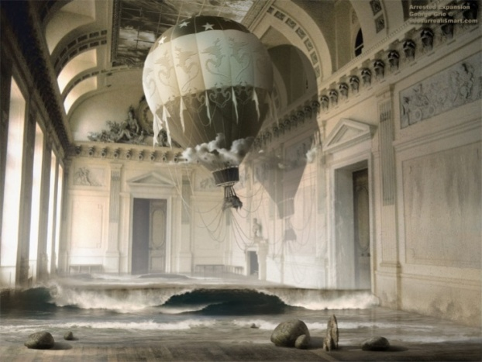

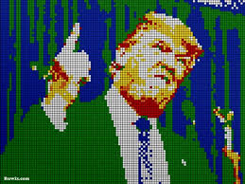
Graphics are used in Fine Art, Commercial Art applications and Mathematical Art. The artist uses a combination of 3D modeling packages, texture mapping, drawing programs and CAD software. Mathematical Art is produced using mathematical functions and fractal procedures. Pen plotters create Automatic Art.
Graphs and charts
Computer-aided design
Virtual-Reality Environments
Scientific visualization
Education and Training
Computer art
Entertainment
Image Processing
Graphical User Interfaces

Slide 14
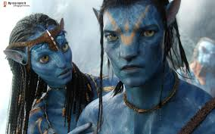



Graphics are commonly used in making motion pictures, music videos and television shows. Graphics objects can be combined with live actions. Eg. Avtar movie
Graphs and charts
Computer-aided design
Virtual-Reality Environments
Scientific visualization
Education and Training
Computer art
Entertainment
Image Processing
Graphical User Interfaces
Jurasic Park

Slide 15
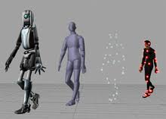

Image processing applies techniques to modify or interpret existing pictures (photographs, TV scans).to apply image processing methods, the image must be digitized first. Medical applications also make extensive use of image processing techniques for picture enhancement, simulations of surgical operations. It used to improve picture quality, analyze or recognize visual patterns.
Graphs and charts
Computer-aided design
Virtual-Reality Environments
Scientific visualization
Education and Training
Computer art
Entertainment
Image Processing
Graphical User Interfaces

Slide 16
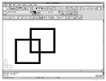
User is provided with point and click facility to select menu items, icons and objects on the screen. User can manage multiple windows simultaneously. Word-processing spreadsheets and desktop-publishing programs are typical applications that take advantage of such user interface techniques.
Graphs and charts
Computer-aided design
Virtual-Reality Environments
Scientific visualization
Education and Training
Computer art
Entertainment
Image Processing
Graphical User Interfaces

Slide 17
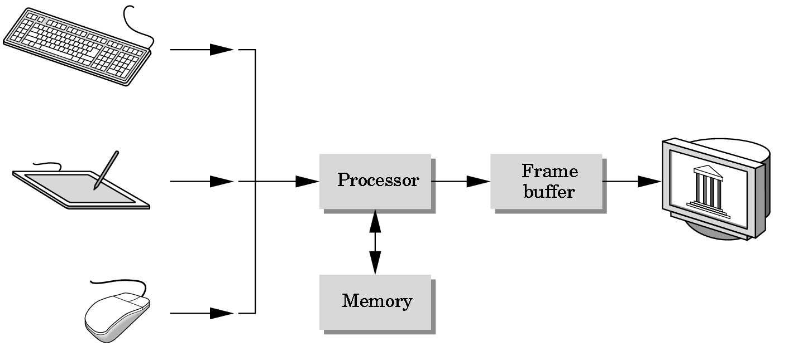
Basic Graphics System
Output device
Input devices
Image formed in FB

Slide 18
Also…
Computer
Graphics
Model
Image
Pattern
Recognition
Image
Processing

Slide 19
From model to image
Model
World
View
NDC
Display
Graphics pipeline
Coordinates and transformations

Slide 20
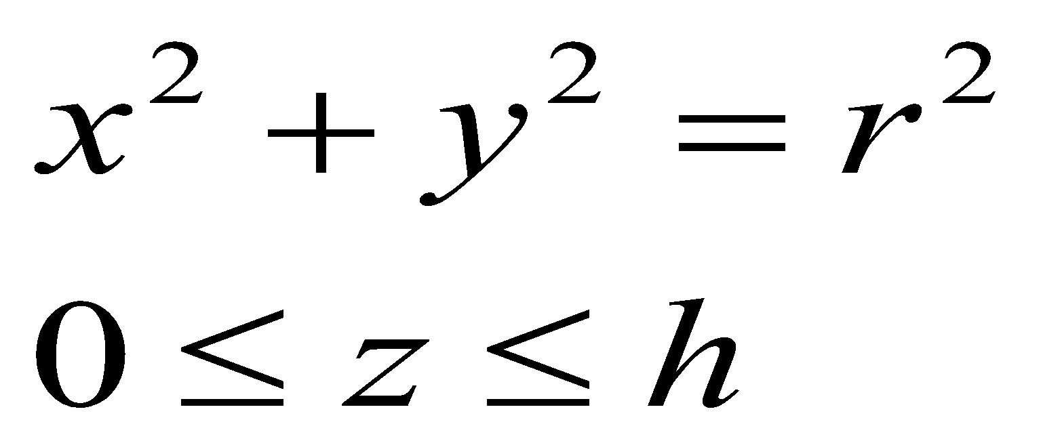
From model to image
Model
World
View
NDC
Display
Cylinder:
Geometric modeling
Local or modeling coordinates

Slide 21
From model to image
Model
World
View
NDC
Display
Position cylinders in scene:
World coordinates

Slide 22
From model to image
Model
World
View
NDC
Display
Look at cylinders,
project on virtual screen
Viewing coordinates
Visible surfaces, shading

Slide 23
From model to image
Model
World
View
NDC
Display
1
Display:
Normalized Device Coordinates
0
1

Slide 24
From model to image
Model
World
View
NDC
Display
0
1024
Display on screen:
Device Coordinates
768
Interaction

Slide 25
Video Display Devices
Emissive display - Convert electrical energy into light
- Cathode ray tube (CRT)
- Flat panel CRT
- Plasma panels (gas-discharge display)
- Thin-film electroluminescent (EL) display
- Light-emitting diodes
Non-Emissive display - Optical effect: convert sunlight or light from other source into graphic patterns.
- Liquid-crystal device (LCD) – flat panel
- Passive-matrix LCD
- Active-matrix LCD

Slide 26
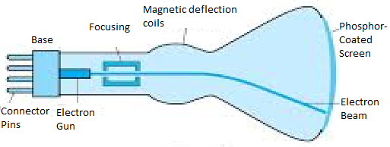
Cathode Ray Tube (CRT)
Cathode Ray – beam of electrons
emitted by an electron gun
accelerated by a high positive voltage near the face of the tube
forced into a narrow stream by a focusing system
directed toward a point on the screen by the magnetic field generated by the deflection coils
hit onto the phosphor-coated screen
phosphor emits visible light, whose intensity depends on the number of electrons striking on the screen
Basic design of a magnetic-deflection CRT

Slide 27
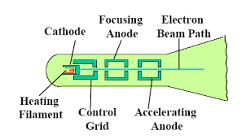
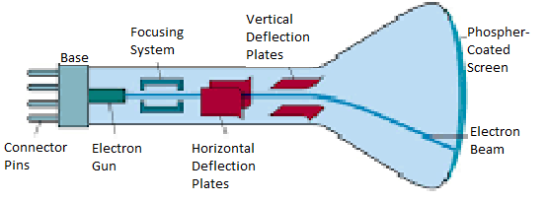
Cathode Ray Tube
Operation of an electron gun with an accelerating anode.
2 primary components: Heated metal cathode and control grid.
Intensity is controlled by voltage at the control grid..
Focusing system forces electron beam to converge to a smaller cross section.
Accelerating anode produces positive voltage.
Electrostatic deflection of the electron beam in a CRT

Slide 28
Cathode Ray Tube (conti…)
Phosphor Persistence (PP)
- the light output decays (fades) exponentially with time.
- a phosphor’s persistence is defined as the time from the removal of excitation to the moment of decaying the light to one-tenth of its original intensity.
- one way: store the picture information as charge distribution, that can be used to keep the phosphor activated.
- now: redraw the picture repeatedly by quickly directing the electron beam back over the same screen points.
- low persistence -> good for animation
- high persistence -> good for static picture with high complexity
- typical range: 10ms – 60ms
Refresh rate (RR) - number of times per second the image is redrawn (e.g., 60 or higher)
Critical fusion frequency (CFF) - the refresh rate above which a picture stops flickering and becomes steady
Longer PP -> lower CFF required

Slide 29
Properties of the CRT
Resolution
- the maximum number of points that can be displayed without overlap on
a CRT
- high-definition system, e.g. 1280 * 1024 pixels
- resolution depends on the type of phosphor, the intensity to be
displayed, focusing and deflection systems, size of video memory
Horizontal scan rate
- the number of scan lines per second that the CRT is able to display
- refresh rate * number of scan lines per frame

Slide 30
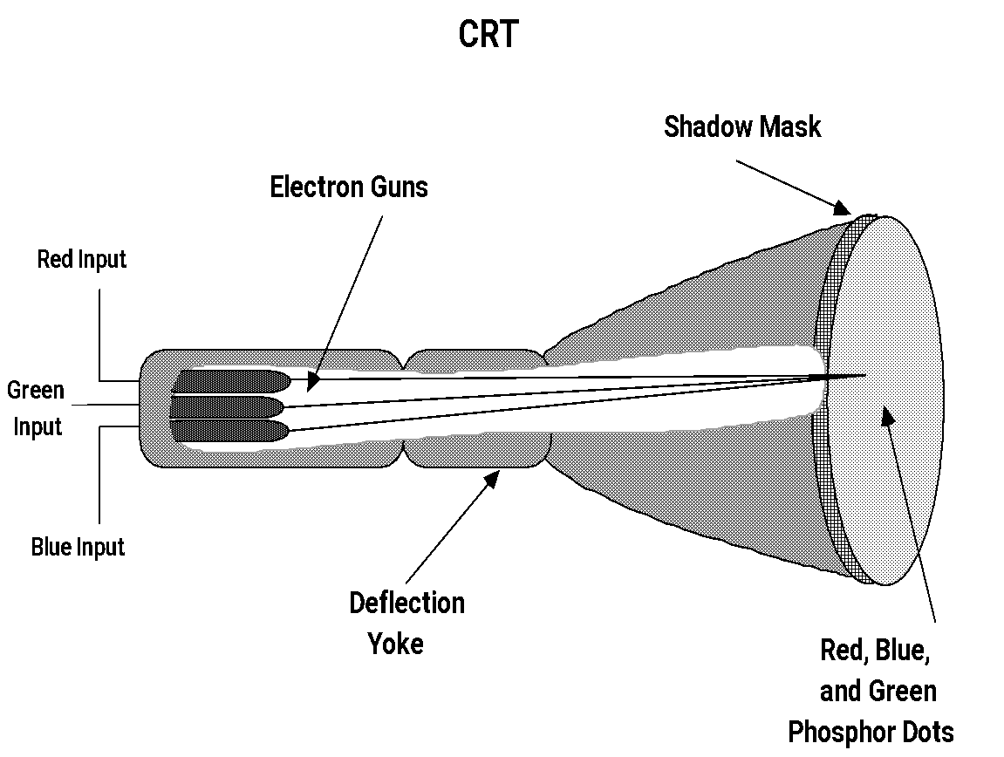
Color CRT Monitor
Displays color pictures by using a combination of phosphors that emit different-colored light and merges to form a single perceived color.

Slide 31
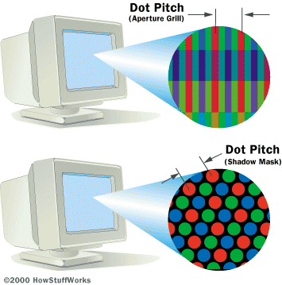
Beam Penetration Method
Coat the screen with layers of different colored phosphors.
Beam of slow electrons excite outer red layer, beam of very fast electrons penetrates through red layer and excites the inner green layer.
(Drawback)Limited to number of colors since only two colors used.
(Drawback)Picture quality is not as good as with the other method.
Dot Pitch –the spacing between pixels on a CRT, measured in millimeters. Generally, the lower the number, the more detailed the image.

Slide 32
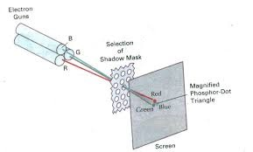
Shadow Mask Method
Uses 3 phosphor color dots at each pixel position, each emitting one of red, blue and green lights.
It has 3 electron guns, one for each color dot and shadow mask grid just behind the phosphor-coated screen.
Shadow mask contains series of holes aligned with phosphor dot patterns, one hole for each phosphor triad.
When the 3 beams pass through a hole in the shadow mask, they activate a dot triangle, which appears as small color spot on the screen. The phosphor dots in the triangles are arranged so that each electron beam can activate only its corresponding color dot when it passes through the shadow mask.
The number of electrons in each beam controls the amount of red, blue and green light generated by the triad.
Another configuration is the in-line arrangement, in which the electron guns and corresponding color dots are aligned along one scan line.
Color CRTs in graphics systems are designed as RGB monitors

Slide 33
Architectures for displaying objects
Vector system Architecture (Random-Scan)
Line drawing and stroke drawing in a random order
Raster Refresh Architecture(Raster-Scan)
Horizontal scan line order

Slide 34
Vector System Architecture(Random-Scan), consists of:
Vector system consists of: display processor (controller), display buffer memory, CRT
In addition to the CPU, a special processor, called the Video controller or Display controller, is used to control the operations of the display device - Connected as an I/O peripheral to the CPU.
Display buffer memory: stores computer-produced display list or display program- contains point and line plotting commands
The commands interpreted by the display processor sends digital and point co-ordinates to vector generator that converts digital co-ordinate values to analog voltages for beam-deflection circuits that displays an electron beam writing on the CRT’s phosphor coating.
Display commands dictate the beam deflection from endpoint to endpoint. This technique is called Random-Scan - Line drawing and stroke drawing in a random order.
Display list needed to be refreshed(Display processor must cycle through the display list- e.g 30Hz)

Slide 35
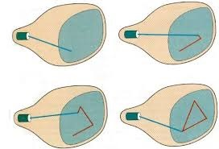
Vector Display
Host Computer
Display cmds
Interaction
:
Move 10,15
LINE 300,400
CHAR Lu, cy
LINE
:
.
.
.
:
JMP
Display Controller (DC)
Monitor
Keyboard/mouse
User
display buffer

Slide 36
Raster Display (since 1970s)
Raster system consists of display processor (input, refreshing, scan converting), video controller, buffer memory (frame buffer), CRT.
The refresh buffer stores the display primitives(lines char and solid shaded or patterned areas), rather than display list or display program.
Raster: set of horizontal raster lines each a row of individual pixels and thus stored as a matrix of pixels representing entire screen.
Video controller reads these pixel contents to produce the actual image on the screen, one raster line at a time, from top to bottom and then back to top.
need refresh the raster display (e.g., 60Hz)

Slide 37
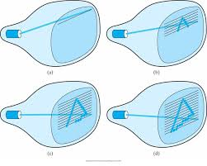
Raster Display
Host Computer
Display cmds
Interaction data
Display Processor
Lucy
Video Controller
Lucy
Frame buffer
Monitor

Slide 38

Basic definitions
Video raster devices display an image by sequentially drawing out the pixels of the scan lines that form the raster.
Raster: A rectangular array of points or dots.
Pixel (Pel, picture elements): One dot or picture element of the raster, defined as smallest addressable area on screen.
Scan line: A row of pixels.
Resolution: # of pixel positions that can be plotted.
Aspect Ratio: # of horizontal points to vertical points(or vice versa).
Depth: # of bits per pixel in a frame buffer.
Bitmap: a frame buffer with one bit per pixel
Pixmap: a frame buffer with multiple bits per pixel.

Slide 39
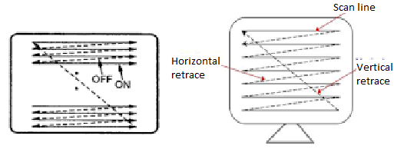
Horizontal retrace: return to the left of the screen, after refreshing each scan line.
Vertical retrace: electron beam returns to the top left corner of the screen to begin the next frame.
Refresh rates are described in units of cycles per seconds, or Hertz(Hz).

Slide 40
Scanning An Image
Frame: The image to be scanned out on the CRT.
Some minimum number of frames must be redisplayed (or refreshed) each second to eliminate flicker in the image.
Critical Fusion Frequency --The refresh rate above which a picture stops flickering and fuses into a steady image is called the critical fusion frequency.
Typically 60 times per second for raster displays.
Varies with intensity, individuals, phosphor persistence, room lighting.

Slide 41
Video Controller
Access the frame buffer to refresh the screen
Control the operation for display
Color look-up table
Linear
address
X
address
Frame
buffer
Raster-scan
generator
Horizontal
& vertical
Deflection signal
Y
address
Data
Pixel
values
Intensity
or color

Slide 42
Types of refresh
Interlaced (mostly for TV for reduced flickering effect -National Television System Committee NTSC) each frame is displayed in two passes or two fields
First pass: The beam sweeps across every other scan line form top to bottom. odd-field: odd-numbered scan lines
Second pass: After vertical retrace, the beam then sweeps out the remaining scan lines. even-field: even-numbered scan lines
Refresh rate: e.g., NTSC: 60Hz (60 fields per second); 30 frame/s. PAL(Phase Alternating Line) : 50Hz
Non-interlaced (mostly for monitor)
refresh rate: e.g., 60Hz or more
Odd-field
Even-field

Slide 43
Display Processor
Also called either a Graphics Controller or Display Co-Processor
Specialized hardware to assist in scan converting output primitives into the frame buffer.
Fundamental difference among display systems is how much the display processor does versus how much must be done by the graphics subroutine package executing on the general-purpose CPU.

Slide 44
Architecture of a raster-graphics system with a display processor
Peripheral
Devices
CPU
System bus
Display Processor
System
Memory
Display
Video
Controller
Display
Processor
Memory
Frame
Buffer

Slide 45
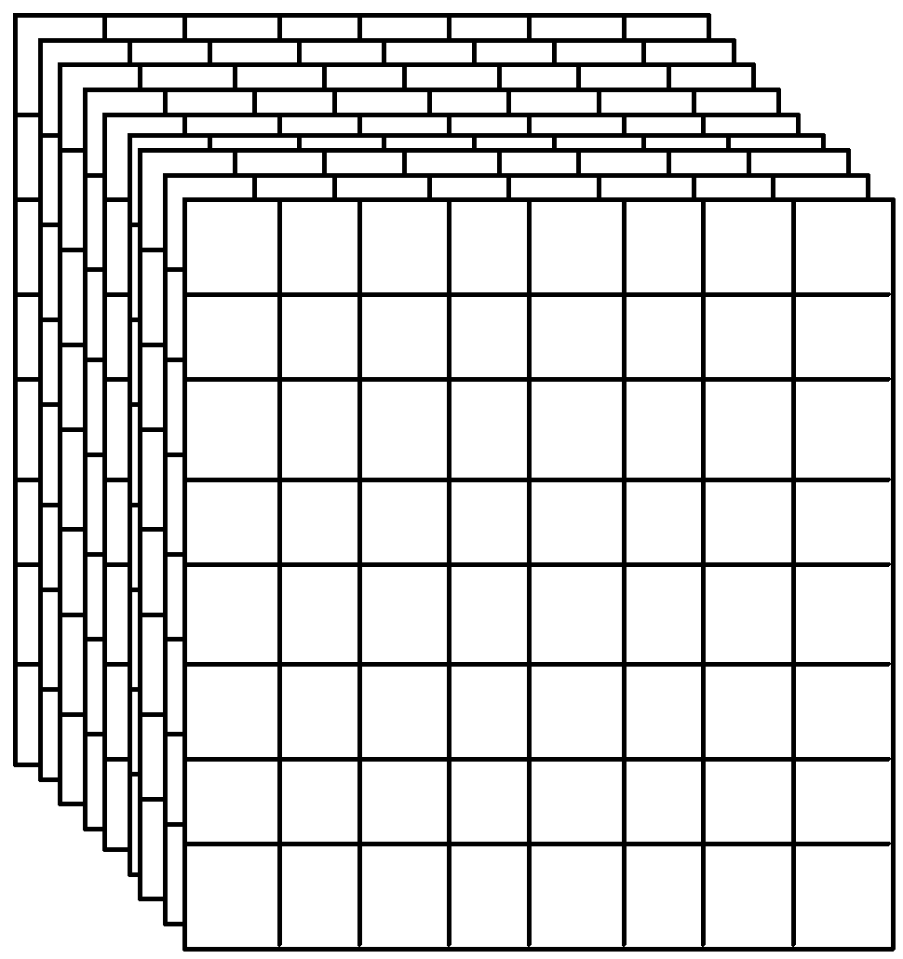
Frame Buffer
A frame buffer may be thought of as computer memory organized as a two-dimensional array with each (x, y) addressable location corresponding to one pixel.
Bit Planes or Bit Depth is the number of bits corresponding to each pixel.
A typical frame buffer resolution might be
640 x 480 x 8
1280 x 1024 x 8
1280 x 1024 x 24

Slide 46
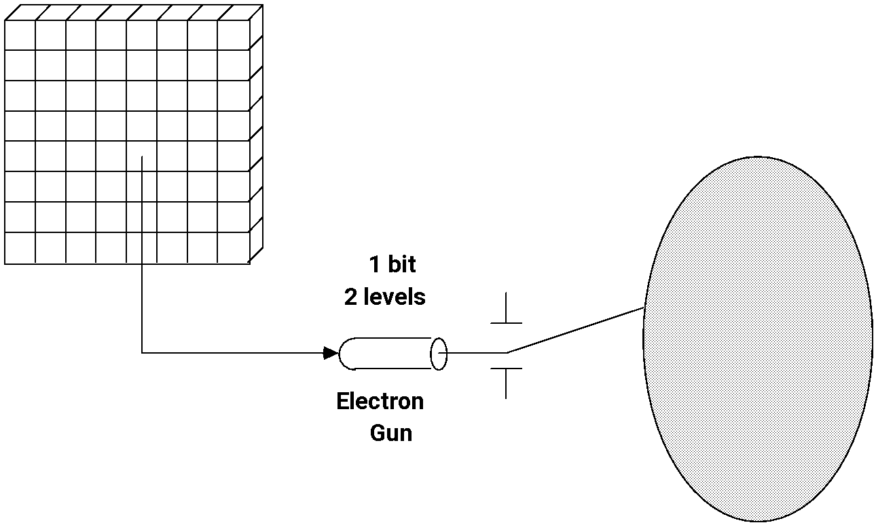
1-Bit Memory. Monochrome Display (Bit-map Display)

Slide 47
3-Bit Color Display
3
red
green
blue
COLOR: black red green blue yellow cyan magenta white
R
0
1
0
0
1
0
1
1
G
0
0
1
0
1
1
0
1
B
0
0
0
1
0
1
1
1

Slide 48
True Color Display 24 bit planes, 8 bits per color gun. 2²⁴ = 16,777,216 colors 32 bit true Color current system 2³² = 4.3 billion colors (1280 X 1024 X 24 ) = 3,840 KB or 3,932,160 bytes
8
8
8
Red
Green
Blue

Slide 49
Color Look-up Table
LUT (Look-Up Table)
LUT has as many entries as there are pixel values, values in the bit planes are used as indices in one or more LUT.
A pixel value is used not to control the beam directly, but rather as an index into the look-up table.
The table entry’s value is used to control the intensity or color of the CRT.
for example:
If each pixel consists of 8 bits in the frame buffer the LUT requires a table with 256 entries.
Pixel value 67 🡪 access the content in the entry 67 of the table 🡪 use the color
content to control the CRT beam
The total number of bits in each table entry is called the width of the LUT,
which is the capability for providing all possible colors
The look-up operation is done for each pixel on each display cycle, fast access of the table is required.
LUT can be loaded on program command.

Slide 50
Color Map Look-Up Tables
y
RED
max
GREEN
255
BLUE
1
1
0
y
0
0
67
Pixel displayed
0
1
1001
1010
0001
at x', y'
0
67
100110100001
Pixel in
R
G
B
bit map
0
0
at x', y'
0
x
x
max
Frame Buffer
Look-up table
Display
Fig. LUT Video look-up table organization. A pixel with value 67 (binary 01000011) is displayed on the screen with the red electron gun at 9/15 of maximum, green at 10/15, and blue at 1/15. This look-up table is shown with 12 bits per entry. Up to 24 bits per entry are common.

Slide 51
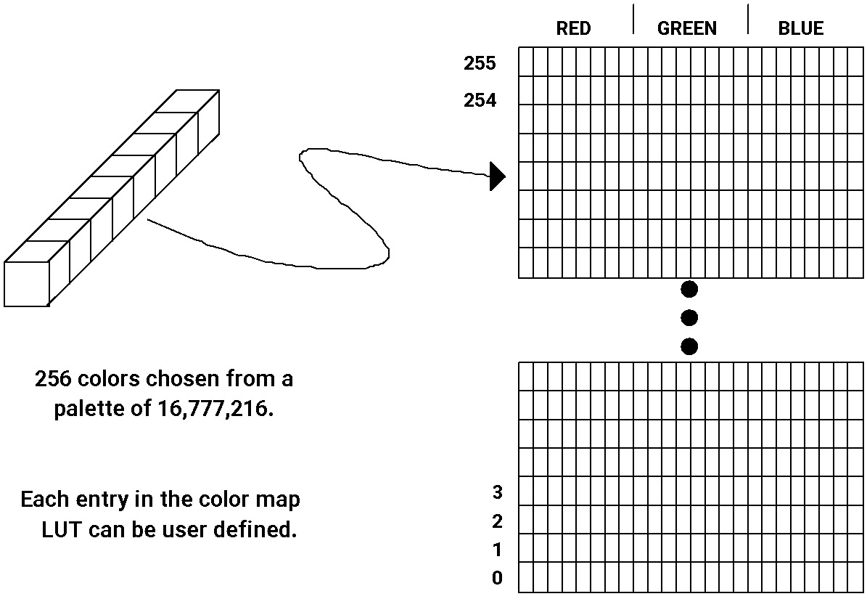
Pseudo Color: 2⁸ x 24 Color Map LUT

Slide 52
Color Look-up Table
The number of the bit planes in the frame buffer🡪 determines the number of colors displayable on the screen simultaneously
The width of the LUT determines the number of possible colors that we can choose from (also called the color palette)
Example:
8 bit planes 🡪 2⁸ or 256 colors can be displayed simultaneously
A LUT width of 12 bits 🡪 color palette consists of 2¹² colors in all

Slide 53
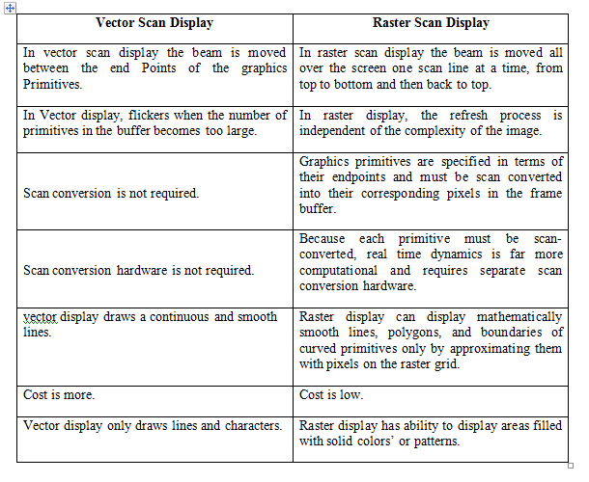

Slide 54
Flat Panel Display
The term flat panel display refers to a class of video device that have reduced volume, weight, power requirement and are thinner than CRTs (that could be hung on walls or worn on wrists).
We can separate flat panel display in two categories:
Emissive displays (Emitters): - convert electrical energy into light.
Eg. Plasma panel,
Thin film electroluminescent displays
Light emitting diodes(LED).
Non emissive displays (Non Emitters): - use optical effects to convert sunlight or light from some other source into graphics patterns.
Eg. Liquid Crystal Display(LCD).

Slide 55
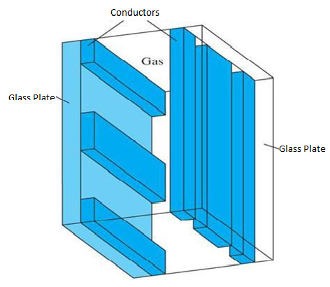
Plasma Panels displays
This is also called gas discharge displays.
It is constructed by filling the region between two glass plates with a mixture of gases that usually includes neon.
A series of vertical conducting ribbons is placed on one glass panel and a set of horizontal ribbon is built into the other glass panel.
Firing voltage is applied to a pair of horizontal and vertical conductors cause the gas at the intersection of the two conductors to break down into glowing plasma of electrons and ions.
Refresh rate: 60 times per second.
Separation between pixels is provided by the electric field of conductor.
Disadvantage: strictly monochromatic device

Slide 56
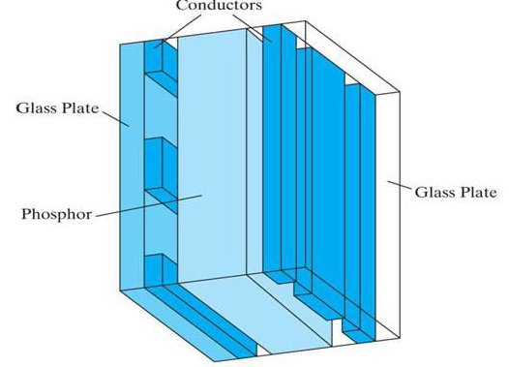
Thin Film Electroluminescent Displays
It is similar to plasma panel display but region between the glass plates is filled with phosphors such as Zinc sulfide doped with magnesium instead of gas.
When sufficient voltage is applied the phosphors becomes a conductor in area of intersection of the two electrodes.
Electrical energy is then absorbed by the manganese atoms which then release the energy as a spot of light similar to the glowing plasma effect in plasma panel.
It requires more power than plasma panel.
In this good color displays are difficult to achieve.

Slide 57
Light Emitting Diode (LED)
In this display a matrix of multi-color light emitting diode is arranged to form the pixel position in the display and the picture definition is stored in refresh buffer.
Similar to scan line refreshing of CRT information is read from the refresh buffer and converted to voltage levels that are applied to the diodes to produce the light pattern on the display.

Slide 58
Liquid Crystal Display (LCD)
This non emissive device produce picture by passing polarized light from the surrounding or from an internal light source through liquid crystal material that can be aligned to either block or transmit the light.
The liquid crystal refreshes to fact that these compounds have crystalline arrangement of molecules then also flows like liquid.
It consists of two glass plates each with light polarizer at right angles to each other sandwich the liquid crystal material between the plates.
Rows of horizontal transparent conductors are built into one glass plate, and column of vertical conductors are put into the other plates.
The intersection of two conductors defines a pixel position.

Slide 59
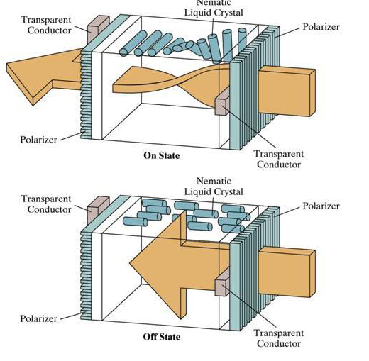
Passive-matrix LCD:
In the ON state polarized light passing through material is twisted so that it will pass through the opposite polarizer, the light is then reflected back to the viewer.
In the OFF state, voltage applied to the two intersecting conductors align the molecules so that the light is not twisted.
Active-matrix LCD:
A transistor is placed at each pixel location, using thin-film transistor technology, that control the voltage at pixel locations and prevent charge from gradually leaking out of the liquid-crystal cells.

Slide 60
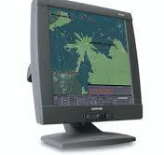
Graphics workstations and viewing systems
Most graphics monitors today operate as raster-scan displays, and both CRT and flat panel systems are in common use.
Graphics workstation range from small general-purpose computer systems to multi monitor facilities, often with ultra –large viewing screens.
High-definition graphics systems, with resolutions up to 2560 by 2048, are commonly used in medical imaging, air-traffic control, simulation, and CAD.
Many high-end graphics workstations also include large viewing screens, often with specialized features.
A high-resolution (2048 by 2048) graphics monitor.

Slide 61
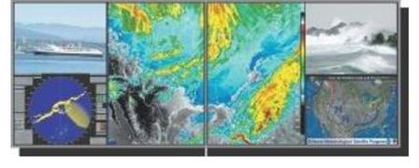
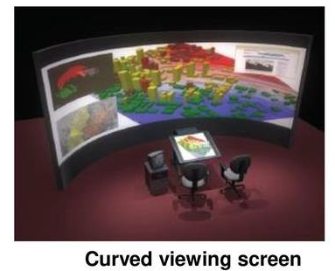
Multi-panel display screens are used in a variety of applications that require “wall-sized” viewing areas. These systems are designed for presenting graphics displays at meetings, conferences, conventions, trade shows, retail stores etc.
A multi-panel display can be used to show a large view of a single scene or several individual images. Each panel in the system displays one section of the overall picture
A large, curved-screen system can be useful for viewing by a group of people studying a particular graphics application.
A multi-panel display system called the “Super Wall”.

Slide 62
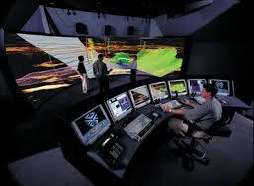
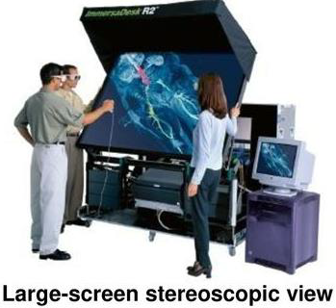
A geophysical visualization presented on a 25 foot semicircular screen, which provides a 160 degree horizontal and 40 degree vertical field of view.
A 360 degree paneled viewing system in the NASA control-tower simulator, which is used for training and for testing ways to solve air-traffic and runway problems at airports.
A large screen stereoscopic view of pressure contours in a vascular blood-flow simulation.

Slide 63
Input devices
Graphics workstations make use of various devices for data input. Most systems have keyboards and mouses, while some other systems have trackball, spaceball, joystick, digitizers, dials, button boxes, data gloves, touch panels, image scanners and voice systems.
Locator Devices
Keyboard
Scanner
Images
Laser
Cameras (research)

Slide 64
Graphical input is more varied than input to standard programs which is usually numbers, characters, or bits
Two older APIs (GKS, PHIGS) defined six types of logical input for graphics
Locator: return a position
Pick: return ID of an object
Keyboard: return strings of characters
Stroke: return array of positions
Valuator: return floating point number
Choice: return one of n items
Why necessary --- To make input devices independent of hardware implementations.

Slide 65

Keyboard
Text input
List boxes, GUI
CAD/CAM
Modeling
Hard coded
Vertex locations are inserted into code
Keyboard on graphics system is used for entering text strings, issuing certain commands and selecting menu options.
Keyboards can also be provided with features for entry of screen coordinates, menu
selections or graphics functions.
General purpose keyboard uses function keys and cursor-control keys.
Function keys allow user to select frequently accessed operations with a single keystroke. Cursor-control keys are used for selecting a displayed object or a location by positioning the screen cursor.

Slide 66
Button Boxes and Dials
Buttons are often used to input predefined functions .Dials are common devices for entering scalar values.
Numerical values within some defined range are selected for input with dial rotations.

Slide 67


Locator Devices
When queried, locator devices return a position and/or orientation.
Mouse (2D and 3D)
Trackball
Joystick (2D and 3D)

Slide 68
Mouse Devices
Mouse is a hand-held device, usually moved around on a flat surface to position the screen cursor. wheeler or roolers on the bottom of the mouse used to record the amount and direction of movement.
Some of the mouses uses optical sensors, which detects movement across the horizontal and vertical grid lines.
Since a mouse can be picked up and put down, it is used for making relative changes in the position of the screen.
Most general purpose graphics systems now include a mouse and a keyboard as the primary input devices.

Slide 69
Trackballs and Spaceballs
A trackball is a ball device that can be rotated with the fingers or palm of the hand to produce screen cursor movement.
Laptop keyboards are equipped with a trackball to eliminate the extra space required by a mouse.
Spaceball is an extension of two-dimensional trackball concept.
Spaceballs are used for three-dimensional positioning and selection operations in virtual reality systems, modeling, animation, CAD and other applications.

Slide 70
Joysticks
Joystick is used as a positioning device, which uses a small vertical lever(stick) mounded on a base. It is used to steer the screen cursor around and select screen position with the stick movement.
A push or pull on the stick is measured with strain gauges and converted to movement of the screen cursor in the direction of the applied pressure.

Slide 71


Locator Devices
When queried, locator devices return a position and/or orientation.
Tablet
Virtual Reality Trackers
Data Gloves
Digitizers

Slide 72

Data Gloves
Data glove can be used to grasp a virtual object. The glove is constructed with a series of sensors that detect hand and finger motions.
Input from the glove is used to position or manipulate objects in a virtual scene.

Slide 73
Digitizers
Digitizer is a common device for drawing, painting or selecting positions.
Graphics tablet is one type of digitizer, which is used to input 2-dimensional coordinates by activating a hand cursor or stylus at selected positions on a flat surface.
A hand cursor contains cross hairs for sighting positions and stylus is a pencil-shaped device that is pointed at positions on the tablet.

Slide 74
Image Scanners
Drawings, graphs, photographs or text can be stored for computer processing with an image scanner by passing an optical scanning mechanism over the information to be stored.
Once we have the representation of the picture, then we can apply various image processing method to modify the representation of the picture and various editing operations can be performed on the stored documents.

Slide 75


Scanners
Image Scanners - Flatbed, etc.
What type of data is returned? Bitmap
Laser Scanners - Deltasphere
Emits a laser and does time of flight. Returns 3D point
Camera based - research
Examine camera image(s) and try to figure out vertices from them.

Slide 76
Touch Panels
Touch panels allow displayed objects or screen positions to be selected with the touch of a finger.
Touch panel is used for the selection of processing options that are represented as a menu of graphical icons.
Optical touch panel-uses LEDs along one vertical and horizontal edge of the frame.
Acoustical touch panels generates high-frequency sound waves in horizontal and vertical directions across a glass plate.

Slide 77
Light Pens
Light pens are pencil-shaped devices used to select positions by detecting the light coming from points on the CRT screen.
To select positions in any screen area with a light pen, we must have some nonzero light intensity emitted from each pixel within that area.
Light pens sometimes give false readings due to background lighting in a room.

Slide 78
Voice Systems
Speech recognizers are used with some graphics workstations as input devices for voice commands. The voice system input can be used to initiate operations or to enter data.
A dictionary is set up by speaking command words several times, then the system analyses each word and matches with the voice command to match the pattern.

Slide 79
Graphics Networks
So far, we have mainly considered graphics applications on an isolated system with a single user.
Multiuser environments & computer networks are now common elements in many graphics applications.
Various resources, such as processors, printers, plotters and data files can be distributed on a network & shared by multiple users.
A graphics monitor on a network is generally referred to as a graphics server.
The computer on a network that is executing a graphics application is called the client.
A workstation that includes processors, as well as a monitor and input devices can function as both a server and a client.

Slide 80
Graphics on Internet
A great deal of graphics development is now done on the Internet.
Computers on the Internet communicate using TCP/IP.
Resources such as graphics files are identified by URL (Uniform resource locator).
The World Wide Web provides a hypertext system that allows users to locate and view documents, audio and graphics.
Each URL sometimes also called as universal resource locator.
The URL contains two parts Protocol- for transferring the document, and Server contains the document.

Slide 81
Graphics Software
There are two broad classifications for computer-graphics software
Special-purpose packages: Special-purpose packages are designed for nonprogrammers
Example: generate pictures, graphs, charts, painting programs or CAD systems in some application area without worrying about the graphics procedure
General programming packages: general programming package provides a library of graphics functions that can be used in a programming language such as C, C++, Java, or FORTRAN.
Example: GL (Graphics Library), OpenGL, VRML (Virtual-Reality Modeling Language), Java 2D And Java 3D
NOTE: A set of graphics functions is often called a computer-graphics application programming interface (CG API)

Slide 82
Graphics Programming/ Software
Development of the OpenGL API (Open Graphics Library Application Program Interface)
OpenGL Architecture
OpenGL as a state machine
Functions
Types
Formats
Simple program

Slide 83
Early History of APIs
IFIPS (1973) formed two committees to come up with a standard graphics API
Graphical Kernel System (GKS) Two versions 2D & 3D
2D but contained good workstation model
Core
Both 2D and 3D
GKS adopted as IS0 and later ANSI standard (1980s)
GKS not easily extended to 3D (GKS-3D)
Far behind hardware development

Slide 84
PHIGS
Programmers Hierarchical Graphics System (PHIGS)
Arose from CAD community
Database model with retained graphics (structures)
X Window System
DEC/MIT effort
Client-server architecture with graphics
PEX combined the two
Not easy to use (all the defects of each)

Slide 85
SGI
Silicon Graphics (SGI) revolutionized the graphics workstation by implementing the pipeline in hardware (1982)
To use the system, application programmers used a library called GL
With GL, it was relatively simple to program three dimensional interactive applications

Slide 86
Low-level 3D API
These APIs for 3D computer graphics are particularly popular:
Direct3D (a subset of DirectX)
Glide
Mantle developed by AMD.
Metal developed by Apple.
MonoGame
OpenGL and the OpenGL Shading Language
OpenGL ES 3D API for embedded devices
QuickDraw 3D developed by Apple Computer starting in 1995, abandoned in 1998
RenderMan, RenderWare
LibGCM
Web-based API
WebGL is a JavaScript interface for OpenGL-ES-2.x API, promoted by Khronos. This is gaining more interest recently, as this enables applications to use native graphics.
High-level 3D API
There are also higher-level 3D scene-graph APIs which provide additional functionality on top of the lower-level rendering API. Such libraries under active development include:
ClanLib
Crystal Space
HOOPS 3D Graphics System
Horde3D
Irrlicht Engine
Java 3D
Java FX
JMonkey Engine
JT Open from Siemens PLM Software
Mobile 3D Graphics API (M3G; JSR-184)
OGRE
OpenGL Performer
OpenSceneGraph
OpenSG
QSDK
VTK

Slide 87
OpenGL
The success of GL lead to OpenGL (1992), a platform-independent API that was
Easy to use
Close enough to the hardware to get excellent performance
Focus on rendering
Omitted windowing and input to avoid window system dependencies

Slide 88
OpenGL Evolution
Controlled by an Architectural Review Board (ARB)
Members include SGI, Microsoft, Nvidia, HP, 3DLabs,IBM,…….
Relatively stable (present version 1.4)
Evolution reflects new hardware capabilities
3D texture mapping and texture objects
Vertex programs
Allows for platform specific features through extensions

Slide 89
OpenGL Libraries
OpenGL core library
OpenGL32 on Windows
GL on most unix/linux systems
OpenGL Utility Library (GLU)
Provides functionality in OpenGL core but avoids having to rewrite code
Links with window system
GLX for X window systems
WGL for Widows
AGL for Macintosh

Slide 90
GLUT
OpenGL Utility Library (GLUT)
Provides functionality common to all window systems
Open a window
Get input from mouse and keyboard
Menus
Event-driven
Code is portable but GLUT lacks the functionality of a good toolkit for a specific platform
Slide bars

Slide 91
Software Organization
application program
OpenGL Motif
widget or similar
GLUT
GLX, AGL or WGL
GLU
X, Win32, Mac O/S
GL
software and/or hardware

Slide 92
OpenGL Architecture
Geometric
pipeline
Immediate Mode
Per Vertex
Operations &
Primitive
Assembly
Polynomial
Evaluator
CPU
Display List
Rasterization
Per Fragment
Operations
Frame
Buffer
Texture
Memory
Pixel
Operations

Slide 93
OpenGL Functions-API’s
Primitives
Points
Line Segments
Polygons
Attributes
Transformations
Viewing
Modeling
Control
Input (GLUT)

Slide 94
OpenGL State
OpenGL is a state machine
OpenGL functions are of two types
Primitive generating
Can cause output if primitive is visible
How vertices are processes and appearance of primitive are controlled by the state
State changing
Transformation functions
Attribute functions

Slide 95
Lack of Object Orientation
OpenGL is not object oriented so that there are multiple functions for a given logical function, e.g. glVertex3f, glVertex2i, glVertex3dv,…..
Underlying storage mode is the same
Easy to create overloaded functions in C++ but issue is efficiency

Slide 96
OpenGL Function Format
function name
3 is Dimension can be 2 or 3
glVertex3f(x,y,z)
x,y,z are floats
belongs to GL library
glVertex3fv(p)
p is a pointer to an array

Slide 97
OpenGL #defines
Most constants are defined in the include files gl.h, glu.h and glut.h
Note #include <GL/glut.h> should automatically include the others
Examples
glBegin(GL_POLYGON)
glClear(GL_COLOR_BUFFER_BIT)
Include files also define OpenGL data types: Glfloat, Gldouble,….

Slide 98
Program Structure
Most OpenGL programs have a similar structure that consists of the following functions
main():
defines the callback functions
opens one or more windows with the required properties
enters event loop (last executable statement)
init(): sets the state variables
viewing
Attributes
callbacks
Display function
Input and window functions

Slide 99
OpenGL Primitives
GL_POINTS
GL_LINES
GL_POLYGON
GL_LINE_STRIP
GL_LINE_LOOP
GL_TRIANGLES
GL_QUAD_STRIP
GL_TRIANGLE_STRIP
GL_TRIANGLE_FAN

Slide 100
Attributes
Attributes are part of the OpenGL state and determine the appearance of objects
Color (points, lines, polygons)
Size and width (points, lines)
Stipple pattern (lines, polygons)
Polygon mode
Display as filled: solid color or stipple pattern
Display edges
Display vertices

Slide 101
Graphics Pipelines
Graphics processes generally execute sequentially
Typical ‘pipeline’ model
There are two ‘graphics’ pipelines
The Geometry or 3D pipeline
The Imaging or 2D pipeline

Slide 102
2D Graphics Pipeline
Clipping
Object
World Coordinates
Applying
world window
Object
subset
window to
viewport
mapping
Simple 2D Drawing Pipeline
Display
Rasterization
Object
Screen coordinates

Slide 103
Rasterization (Scan Conversion)
Convert high-level geometry description to pixel colors in the frame buffer
Example: given vertex x, y coordinates determine pixel colors to draw line
Two ways to create an image:
Scan existing photograph
Procedurally compute values (rendering)
Viewport Transformation
Rasterization

Slide 104
Rasterization
A fundamental computer graphics function
Determine the pixels’ colors, illuminations, textures, etc.
Implemented by graphics hardware
Rasterization algorithms
Lines
Circles
Triangles
Polygons

Slide 105
Rasterization Operations
Drawing lines on the screen
Manipulating pixel maps (pixmaps): copying, scaling, rotating, etc
Compositing images, defining and modifying regions
Drawing and filling polygons
Previously glBegin(GL_POLYGON), etc
Aliasing and anti-aliasing methods

Slide 106
Line drawing algorithm
Programmer specifies (x,y) values of end pixels
Need algorithm to figure out which intermediate pixels are on line path
Pixel (x,y) values constrained to integer values
Actual computed intermediate line values may be floats
Rounding may be required. E.g. computed point
(10.48, 20.51) rounded to (10, 21)
Rounded pixel value is off actual line path (jaggy!!)
Sloped lines end up having jaggies
Vertical, horizontal lines, no jaggies

Slide 107
Line Drawing Algorithm
Line: (3,2) -> (9,6)
6
5
?
4
Which intermediate
pixels to turn on?
3
2
1
0 1 2 3 4 5 6 7 8 9 10 11 12

Slide 108


Line Drawing Algorithm
Slope-intercept line equation
y = mx + b Equation of Line where m is slope & b is intercept
Given two end points (x0,y0), (x1, y1), how to compute m and b?
(x1,y1)
dy
(x0,y0)
dx

Slide 109

Line Drawing Algorithm
Numerical example of finding slope m:
(Ax, Ay) = (23, 41), (Bx, By) = (125, 96)

Slide 110
Digital Differential Analyzer (DDA): Line Drawing Algorithm
Walk through the line, starting at (x0,y0)
Constrain x, y increments to values in [0,1] range
Case a: x is incrementing faster (m < 1)
Step in x=1 increments, compute and round y
Case b: y is incrementing faster (m > 1)
Step in y=1 increments, compute and round x
(x1,y1)
dy
(x0,y0)
dx

Slide 111

DDA Line Drawing Algorithm (Case a: m < 1)
x = x0 y = y0
Illuminate pixel (x, round(y))
(x1,y1)
x = x0 + 1
y = y0 + 1 * m
Illuminate pixel (x, round(y))
x = x + 1
y = y + 1 * m
Illuminate pixel (x, round(y))
…
Until x == x1
(x0, y0)

Slide 112

DDA Line Drawing Algorithm (Case b: m > 1)
x = x0 y = y0
(x1,y1)
Illuminate pixel (round(x), y)
y = y0 + 1
x = x0 + 1 * 1/m
Illuminate pixel (round(x), y)
y = y + 1
x = x + 1 /m
Illuminate pixel (round(x), y)
…
(x0,y0)
Until y == y1

Slide 113
DDA Line Drawing Algorithm Pseudocode
compute m;
if m < 1:
{
float y = y0; // initial value
for(int x = x0;x <= x1; x++, y += m)
setPixel(x, round(y));
}
else // m > 1
{
float x = x0; // initial value
for(int y = y0;y <= y1; y++, x += 1/m)
setPixel(round(x), y);
} Note: setPixel(x, y) writes current color into pixel in column x and row y in frame buffer

Slide 114
DDA Line Drawing Algorithm Drawbacks
DDA is the simplest line drawing algorithm
Not very efficient
Round operation is expensive
Optimized algorithms typically used.
Integer DDA
Eg. Bresenham algorithm (Hill, 10.4.1)
Bresenham algorithm
Incremental algorithm: current value uses previous value
Integers only: avoid floating point arithmetic
Several versions of algorithm: we’ll describe midpoint version of algorithm

Slide 115
Bresenham’s Line-Drawing Algorithm
Accurate and efficient
Uses only incremental integer calculations
The method is described for a line segment with a positive slope less than one
The method generalizes to line segments of other slopes by considering the symmetry between the various octants and quadrants of the xy plane

Slide 116
Bresenham’s Line-Drawing Algorithm
Decide what is the next pixel position
(11,11) or (11,12)
13
Specified
line path
12
11
10
10
11
12
13

Slide 117
Bresenham’s Line-Drawing Algorithm
y_{k+3}
For the pixel position x_{k+1}=x_{k}+1, which one we should choose:
(x_{k+1},y_{k}) or (x_{k+1}, y_{k+1})
y_{k+2}
y=mx+b
y_{k+1}
y_{k}
x_{k}
x_{k+1}
x_{k+2}
x_{k+3}

Slide 118
Bresenham’s Approach
y=m(x_{k} + 1)+b
d_{lower}=y-y_{k}
=m(x_{k} + 1)+b-y_{k}
d_{upper}=(y_{k}+1)-y
= y_{k}+1 -m(x_{k} + 1)-b
y_{k+1}
d_{upper}
y
d_{lower}
y_{k}
x_{k+1}
d_{lower}- d_{upper}= 2m(x_{k} + 1)-2y_{k}+2b-1
Rearrange it to have integer calculations:
m=Δy/Δx
Decision parameter: p_{k}= Δx(d_{lower}- d_{upper})=2Δy.x_{k} - 2Δx. y_{k} +
c

Slide 119
The Decision Parameter
Decision parameter: p_{k}= Δx(d_{lower}- d_{upper})=2Δy.x_{k} - 2Δx. y_{k} + c
p_{k} has the same sign with d_{lower}- d_{upper} since Δx>0.
c is constant and has the value c= 2Δy + Δx(2b-1)
c is independent of the pixel positions and is eliminated from decision parameter p_{k}.
If d_{lower}< d_{upper} then p_{k} is negative.
Plot the lower pixel (East)
Otherwise
Plot the upper pixel (North East)

Slide 120
Successive decision parameter
At step k+1
p_{k+1}= 2Δy.x_{k+1} - 2Δx. y_{k+1} + c
Subtracting two subsequent decision parameters yields:
p_{k+1}-p_{k}= 2Δy.(x_{k+1}-x_{k}) - 2Δx. (y_{k+1}-y_{k})
x_{k+1}=x_{k}+1 so
p_{k+1}= p_{k} + 2Δy - 2Δx. (y_{k+1}-y_{k})
y_{k+1}-y_{k} is either 0 or 1 depending on the sign of p_{k}
First parameter p₀
p₀=2 Δy - Δx

Slide 121
Bresenham's Line-Drawing Algorithm for |m| < 1
Input the twoline endpoints and store the left endpoint in (x₀ ,y₀).
Load (x₀ ,y₀) into the frame buffer; that is, plot the first point.
Calculate constants Δx, Δy, 2Δy, and 2Δy - 2Δx, and obtain the starting value for the decision parameter as
p₀=2 Δy - Δx
4. At each x_{k} along the line, starting at k = 0, perform the following test:
If p_{k} < 0, the next point to plot is (x_{k+1}, y_{k}) and
p_{k+1}=p_{k} + 2Δy
Otherwise, the next point to plot is (x_{k+1}, y_{k+1}) and
p_{k+1}=p_{k} + 2Δy - 2Δx
5. Repeat step 4 Δx -1 times.

Slide 122



Trivial Situations: Do not need Bresenham

Slide 123

Example
Draw the line with endpoints (20,10) and (30, 18).
Δx=30-20=10, Δy=18-10=8,
p₀ = 2Δy – Δx=16-10=6
2Δy=16, and 2Δy - 2Δx=-4
Plot the initial position at (20,10), then

Slide 124

Example

Slide 125



Example
Line end points:
Deltas:
initially

Slide 126
Pseudocode
/* Bresenham line-drawing procedure for |m| < 1.0. */
void lineBres (int x0, int y0, int xEnd, int yEnd)
{
int dx = fabs (xEnd - x0), dy = fabs(yEnd - y0);
int x, y, p = 2 * dy - dx;
int twoDy = 2 * dy, twoDyMinusDx = 2 * (dy - dx);
/* Determine which endpoint to use as start position. */
if (x0 > xEnd) {
x = xEnd; y = yEnd; xEnd = x0;
}
else {
x = x0; y = y0;
}
setPixel (x, y);

Slide 127
Pseudocode
while (x < xEnd) {
x++;
if (p < 0)
p += twoDy;
else {
y++;
p += twoDyMinusDx;
}
setPixel (x, y);
}
}

Slide 128




Scan Converting Circles
3 Methods: Parametric, Trignometric & mid-point
1 Parametric method
Explicit: y = f(x)
We could draw a quarter circle by incrementing x from 0 to R in unit steps and solving for +y for each step.
Method needs lots of computation, and gives non-uniform pixel spacing

Slide 129

Scan converting Circles
2 Trignometric :
Draw quarter circle by stepping through the angle from 0 to 90
avoids large gaps but still unsatisfactory
How to set angular increment
Computationally expensive trigonometric calculations

Slide 130
Circle Generation with mid-point
Implicit: f(x,y) = x²+y²-R²
If f(x,y) = 0 then it is on the circle.
f(x,y) > 0 then it is outside the circle.
f(x,y) < 0 then it is inside the circle.
Try to adapt the Bresenham midpoint approach
Again, exploit symmetries

Slide 131

Circle Symmetry

Slide 132
Generalising the Bresenham midpoint approach
Set up decision parameters for finding the closest pixel to the cırcumference at each sampling step
Avoid square root calculations by considering the squares of the pixel separation distances
Use direct comparison without squaring.
Adapt the midpoint test idea: test the halfway position between pixels to determine if this midpoint is inside or outside the curve
This gives the midpoint algorithm for circles
Can be adapted to other curves: conic sections

Slide 133


Eight-way Symmetry only one octant’s calculation needed

Slide 134
The 2nd Octant is a good arc to draw
It is a well-defined function in this domain
single-valued
no vertical tangents: |slope|  1
Lends itself to the midpoint approach
only need consider E or SE
Implicit formulation F(x,y) = x ² + y ² – r ²
For (x,y) on the circle, F(x,y) = 0
F(x,y) > 0 ⇒ (x,y) Outside
F(x,y) < 0 ⇒ (x,y) Inside

Slide 135
The 2nd Octant is a good arc to draw
Decision variable d is x ² + y ² – r ²
Then d = F(M)  0 ⇒ SE
Or d = F(M) < 0 ⇒ E

Slide 136




F (M)  0 ⇒ SE
current pixel
ideal curve

Slide 137
F (M) < 0 ⇒ E
ideal curve

Slide 138
As in the Bresenham line algorithm we use a decision variable to direct the selection of pixels.
Use the implicit form of the circle equation
p = F (M ) = x ² + y ² – r ²

Slide 139


Midpoint coordinates are

Slide 140

Assuming we have just plotted point at (xk,yk) we determine whether move E or SE by evaluating the circle function at the midpoint between the two candidate pixel positions
pk is the decision variable
if pk <0 the midpoint is inside the circle
Thus the pixel above the midpoint is closer to the ideal circle, and we select pixel on scan line yk. i.e. Go E

Slide 141

If pk >0 the midpoint is outside the circle.
Thus the pixel below the midpoint is closer to the ideal circle, and we select pixel on scan line yk-1. i.e. Go SE
Calculate successive decision parameter values p by incremental calculations.

Slide 142

recursive definition for successive decision parameter values p
Where yk+1 = yk if p<0 (move E)
yk+1 = yk-1 if p>0 (move SE) yk+1 and xk+1 can also be defined recursively

Slide 143

Initialisation
x₀ = 0, y₀ = r
Initial decision variable found by evaluating circle function at first midpoint test position
For integer radius r p₀ can be rounded to p₀ =1-r
since all increments are integer.

Slide 144


Slide 146



Slide 147

r=10

Slide 148
Example

Slide 149
End of Module 1

